Slide 1

Socioeconomic Factors and the ACT
Sean Li

Slide 2

Problem
Can we predict ACT Scores from socioeconomic factors?
Would location be valuable in predicting ACT scores?
Datasets – ACT scores and factors such as education, income, etc.
EdGap_data.xlsx - https://www.edgap.org
ccd_sch_029_1617_w_1a_11212017.csv - https://www.dropbox.com/s/lkl5nvcdmwyoban/ccd_sch_029_1617_w_1a_11212017.csv?dl=0

Slide 3
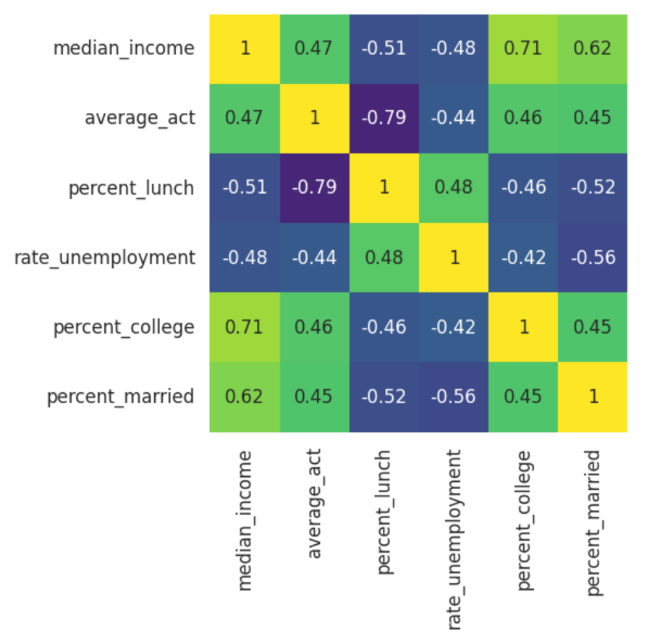
Analysis
Correlation matrix to identify relationships
Many seem to be significant
percent_lunch better by far
Analyze subsets
Find best adjusted r-value for each subset size
Compare across different subset sizes with AIC & BIC values

Slide 4
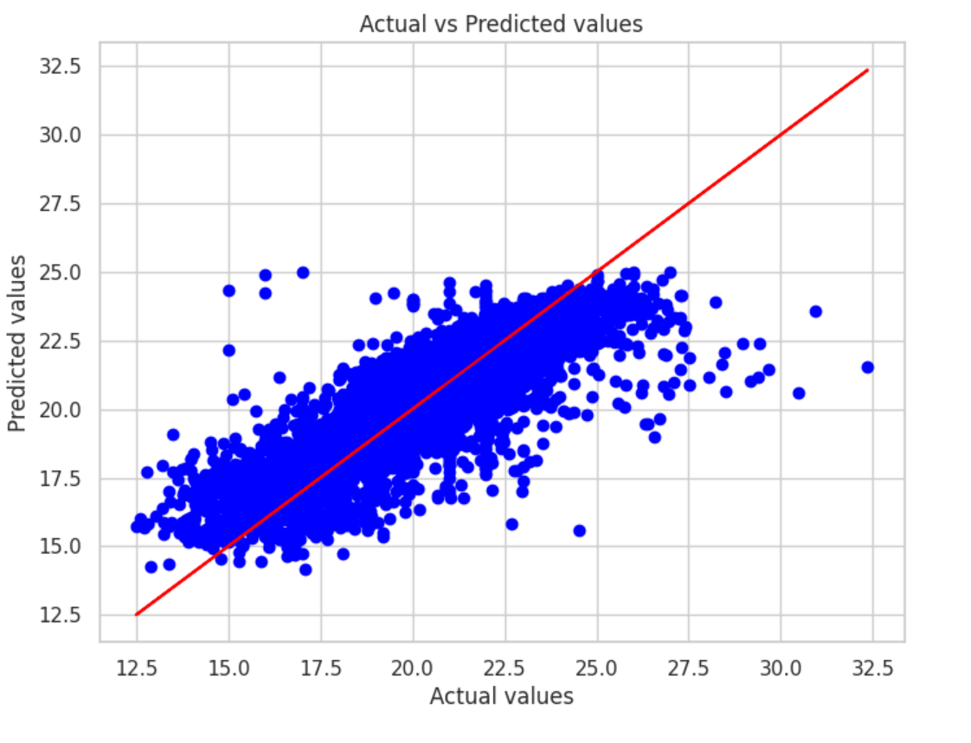
Conclusion
Best Variable: percent_lunch
Best Subset: percent_lunch, state, percent_college
Model R-Squared: 0.687

